Slide 1
A civil court action

Slide 2
A decision to make
When a person’s rights have been infringed they can decide to take the matter further or not.
If they decide to take further action, they must decide whether they will use the court system or an alternative method of dispute resolution.
Generally, the parties to a legal action are known as litigants.

Slide 3
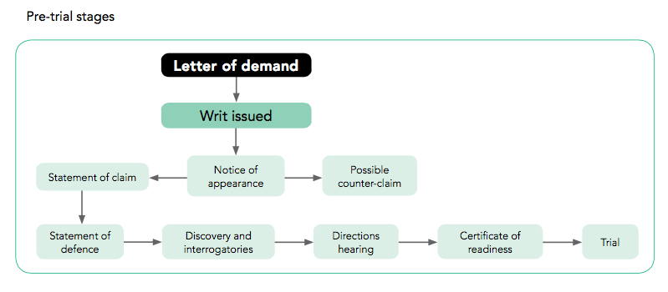
Pre Trial

Slide 4
Pre-hearing procedures
The procedures used in civil cases vary depending on the court.
The purpose of civil pre- trial procedures is to determine the relevant facts of the case and to assist the parties to gather evidence to be used in court.
It also assists in ensuring a speedy resolution of the matter.
In fact, most civil cases are settled out of court, during the pre-hearing stages.

Slide 5
Letter of demand
Before taking the matter to court, a plaintiff may attempt to gain a resolution and obtain a remedy by sending a letter of demand to the defendant.
This letter, usually written by the plaintiff’s solicitor, outlines the nature of the complaint and outlines the demands of the plaintiff.
This letter warns the defendant that should the demands of the plaintiff not be met further court action will be taken.
The defendant usually has 14 days to meet the plaintiff’s demands.

Slide 6
How do you know in which court to bring your case?
The remedy claimed by the plaintiff determines the court to which the matter will be brought.
This is one of the reasons a court hierarchy is necessary.
The amount of damages sought determines whether the case will be heard in the Magistrates’, County or Supreme Court.

Slide 7
Writ
Proceedings begin when the plaintiff files a writ with the court.
The writ contains the names and addresses of the plaintiff and the defendant, information about the place and mode of trial (that is, before a judge alone or a judge and jury) and the name and address of the plaintiff’s solicitor.
This writ must be served on the defendant in person, or posted or delivered to the defendant’s address.

Slide 8
Notice of appearance
After the writ has been led and served, a notice of appearance is completed by the defendant.
This indicates to the court and the plaintiff that the defendant wishes to defend the matter.
The notice of appearance is then served to the court and delivered to the plaintiff.

Slide 9
Pleadings
Pleadings is the name of the formal system where the parties exchange documents and details of the case.
- Statement of claim
A statement of claim often accompanies a writ.
The statement of claim is produced by the plaintiff and sets out the circumstances relevant to the claim and the outcome sought by the plaintiff.
- Defense
The defendant will usually put forward a statement (or notice) of defense in response to the plaintiff’s statement of claim.
- Counterclaim
The defendant may also issue a counterclaim against the plaintiff. In a counterclaim the defendant claims that the plaintiff is partly responsible for the damage or loss claimed.

Slide 10
Discovery process
At the end of pleadings either side may require the production of documents relevant to the case, to assist in clarifying any of the issues.
Any requested documents must be provided by the other side. This is called the discovery of documents.
Interrogatories is the name given to the process whereby written questions are served by both sides and must be answered under oath. The answers to these questions are admissible as evidence in court, should the matter proceed to a hearing.

Slide 11
Directions hearings
Directions hearings allow the court to be involved in some of the pre-trial stages leading up to a case being heard by the court.
The aim of directions hearings is to ensure that proceedings are conducted in an effective and timely manner.
The court may ask the parties to come to an agreement about certain facts that are clear, so that court time is not taken up with this material.

Slide 12
Certificate of readiness for trial
Once these procedures have been completed, the plaintiff will file a certificate of readiness for trial.

Slide 13
Today
Case File ‘Lights out at Beacon View’
Read the Case File, pages 292-296
Complete the questions on pages 296-7

