Slide 1
The Court Hierarchy
Area of Study 3

Slide 2
What is it?
Courts are organized in a hierarchy or ranking in order of importance according to their jurisdiction or the types of cases heard and determined.
Courts have both original and appellate jurisdiction.

Slide 3
Original vs. Appellate
Original Jurisdiction
Is where the cases are heard for the first time
Appellate Jurisdiction
Is where cases are heard on appeal

Slide 4
Why do we have a court hierarchy?
The primary reason for a court hierarchy is to resolve conflict by enforcing the law.
We rank our courts for 4 specific reasons
Specialization
Appeals
Precedent
Administrative Convenience

Slide 5
specialization
This allows judges and magistrates to gain great skills and expertise in the particular matters they hear, and promotes consistency in decision-making.
For example, a magistrates in the Children's court will be able to use their expertise to deal with cases in a uniform matter
Appeals
A hierarchy allows the decisions of a court lower in the system to be reviewed on appeal, if necessary, by a higher court.
This appeals process promotes fairness and is a safeguard against unjust decisions

Slide 6
Precedent
The use of past decisions in determining current cases relies heavily on the existence of a hierarchy.
Useually only one of the higher courts sets a precedent, which become binding and is followed by lower courts
Administrative convenience
It is more effective to have cases of a similar nature being heard by a particular court.
It is alos a better use of resources. For example it makes sense to have more personnel and courts at the magistrates level as most cases are heard here.

Slide 7
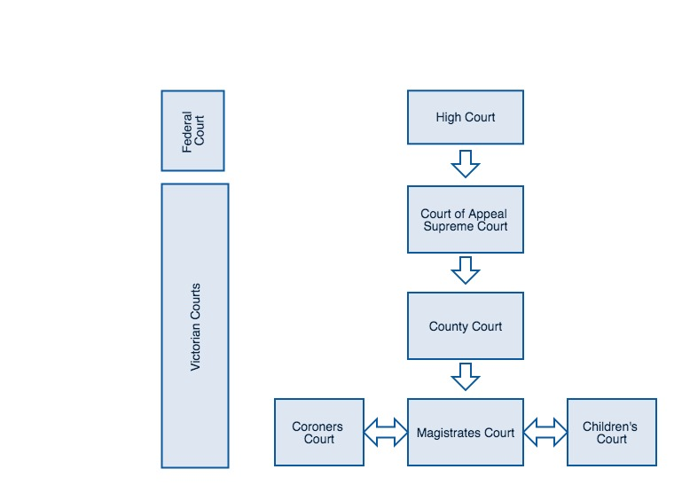
The Victorian court hierarchy

