Slide 1
DEFENCES TO CRIME

Slide 2
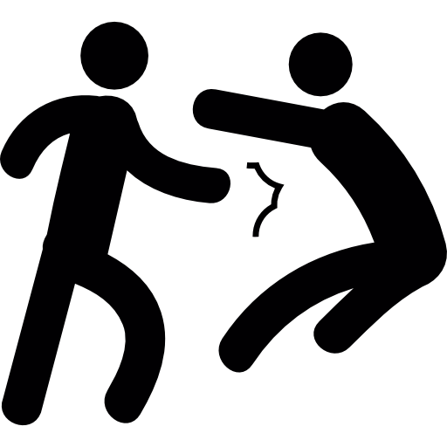
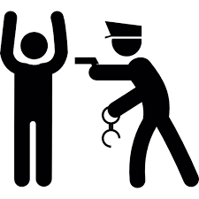
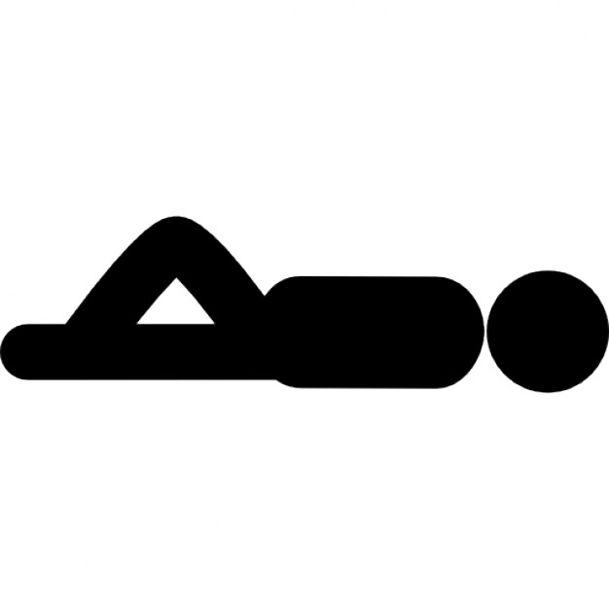
SELF DEFENCE
Use of force to protect oneself.
Force must be reasonable.
No force greater than the attacker uses.
Normally Self Defense only applies when defendant is responding
to an immediate attack, accept in family violence case.
In that case the court can look at the impact of a history of violence
eg. ‘Battered Spouse Syndrome’

Slide 3
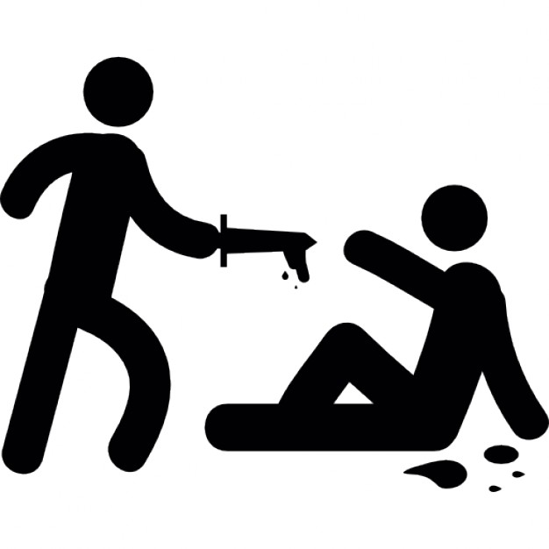
DEFENSIVE HOMICIDE
When a accused commits an act causing death believing they were acting in self defense but in the courts view the action was not reasonable

Slide 4
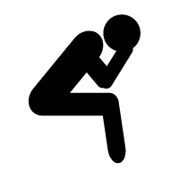
MENTAL IMPAIRMENT
Mental impairment can be used when a person is suffering mental illness at the time they committed a crime.
To use the defense of mental impairment the person must prove…
They did not know the nature and quality of their actions
They did not know that their actions were wrong.

Slide 5
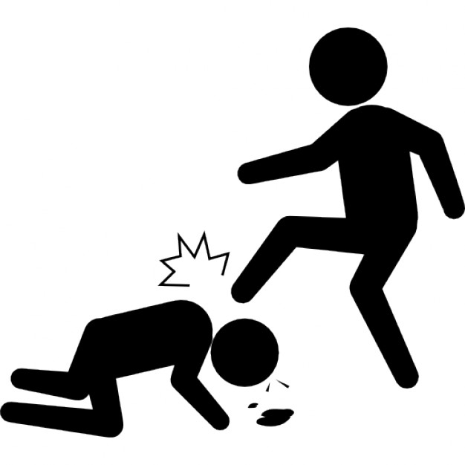
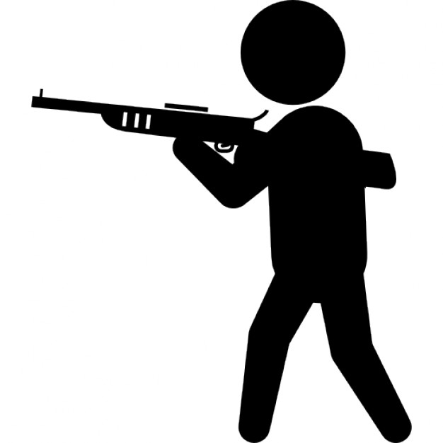
DURESS
A person is not guilty of an offence if they committed the act under duress.
Duress is the use of threat or force to make someone do something.

Slide 6
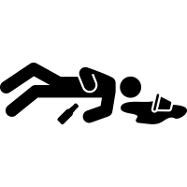
INTOXICATION
Intoxication can be claimed if the accused was so under the influence of drugs or alcohol that they did not know what they were doing and therefore the accused is unable to form the mens rea (guilty mind) to commit a crime.

Slide 7
SUDDEN
OR
EXTRAORDINARY EMERGENCY
A person is not guilty of homicide if the act is necessary due to sudden or extraordinary emergency.
This defense can be claimed in murder, manslaughter and defensive homicides.

Slide 8
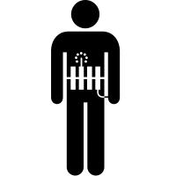
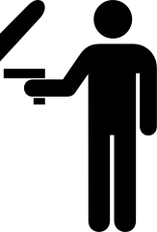
NECESSITY
Necessity can be used as a defense in circumstances where a person causes harm in order to prevent greater harm.
The act must be proportionate to the harm they intended to avoid

Slide 9
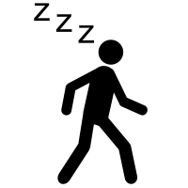
AUTOMATISM
Where actions are not controlled by a defendants conscious mind eg.
Sleep Walking
Hypnotized
Epileptic Fit
Concussion

Slide 10
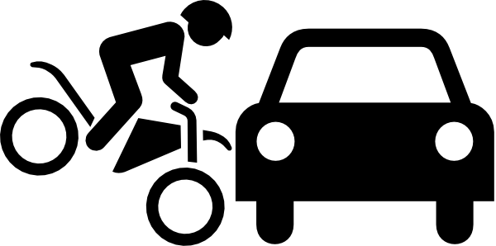
ACCIDENT
Defense can be used when something happens beyond a persons control or as an unexpected result of a lawful act.
If accepted it is because mens rea did not exist.

Slide 11
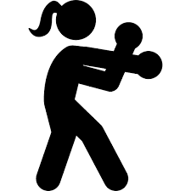
CONSENT
Consent can only be used in very specific circumstances
Consent could be used if someone was killed on a sporting field. In this case the victim has accepted the risks that come with some sports.

