Slide 1
Welcome to legal studies
2017

Slide 2
Will I be your teacher?

Slide 3
What is expected of you next year

Slide 4
expectations
Be in class on time
Hand the work in on time
Be respectful to other class mates
Bring all materials required to class.
Bring a water bottle to class.
If you cant work next to your mates, don’t sit next to them
Use all resources at your disposal
Textbook
Weebly
Take QUALITY notes

Slide 5
What do you need to bring to class?
An Exercise book
Pens/Pencils
Your Laptop
A Copy of the Txt book
I would suggest you download a digital version of the txt book for your device as well. This will stop some of the awkwardness if you leave your txt book at home after studying really hard for days on end.
Even if you plan to take notes on your Laptop, you will still need a legal studies exercise book and pens and pencils in class

Slide 6
The fun stuff

Slide 7
excursions
2 excursions this year.
Excursion 2 – Geelong Magistrates Court
We will visit the magistrates court for the day and look at how the court system works.
Excursion 1 – Barwon Maximum Security Prison
You will be visiting the maximum security prison in Barwon and talking to prisoners about their crimes, how they were caught, why they were caught, their jail experience and general questions about their lives.
You usually will speak too 8 prisoners. 5 are usually in for Murder

Slide 8
The Weebly
Put this in your Bookmarks now.
This might change a bit depending on who teaches you next year.
http://scsc11legal.weebly.com
Never forget this website!

Slide 9
The weebly
The weebly has everything you need to know.
It has practice exam questions
The content you are meant to be learning
Information on SACs
Information on Exams
KK information

Slide 10
KK tasks
You will receive KK tasks.

Slide 12
Click on unit 1
This is the rough outline to each week in Legal Studies 2016 Semester 1.
Take a look at it.
It is subject to change in the next month depending on timetabling.
Have a look at when your SACs are
Take a peak at the information we will be covering

Slide 13
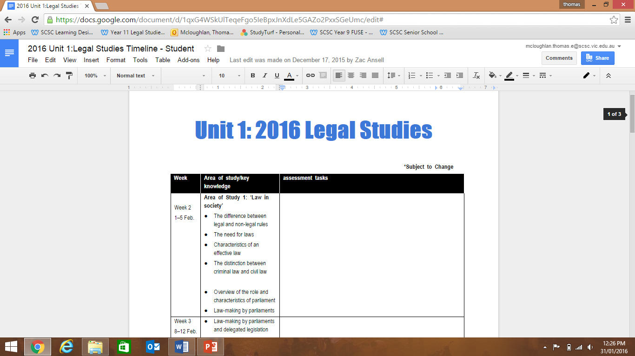
Please download this document.

Slide 14
Important dates:

Slide 15
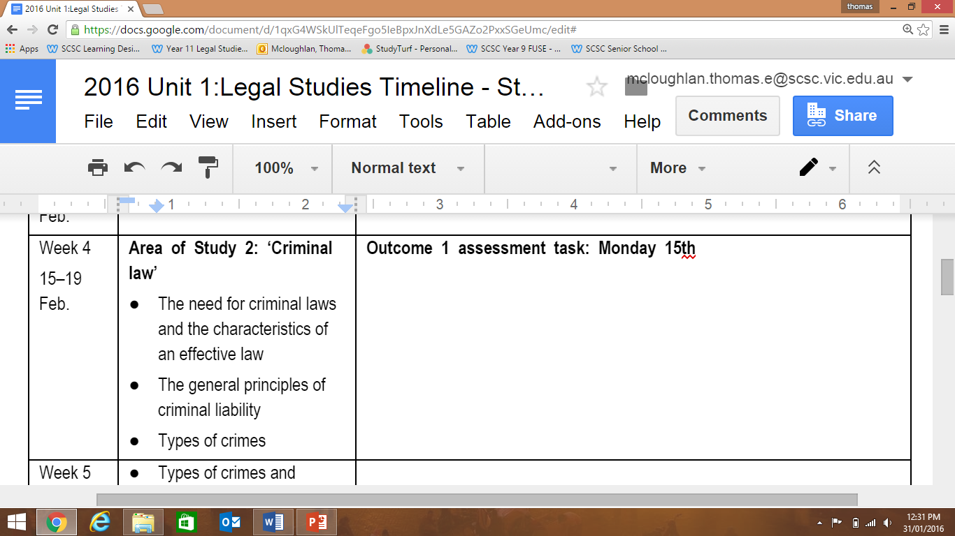

Slide 16
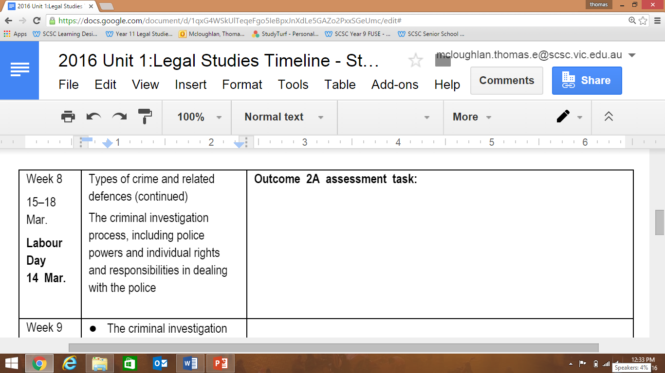
This SAC is split over two parts.

Slide 17
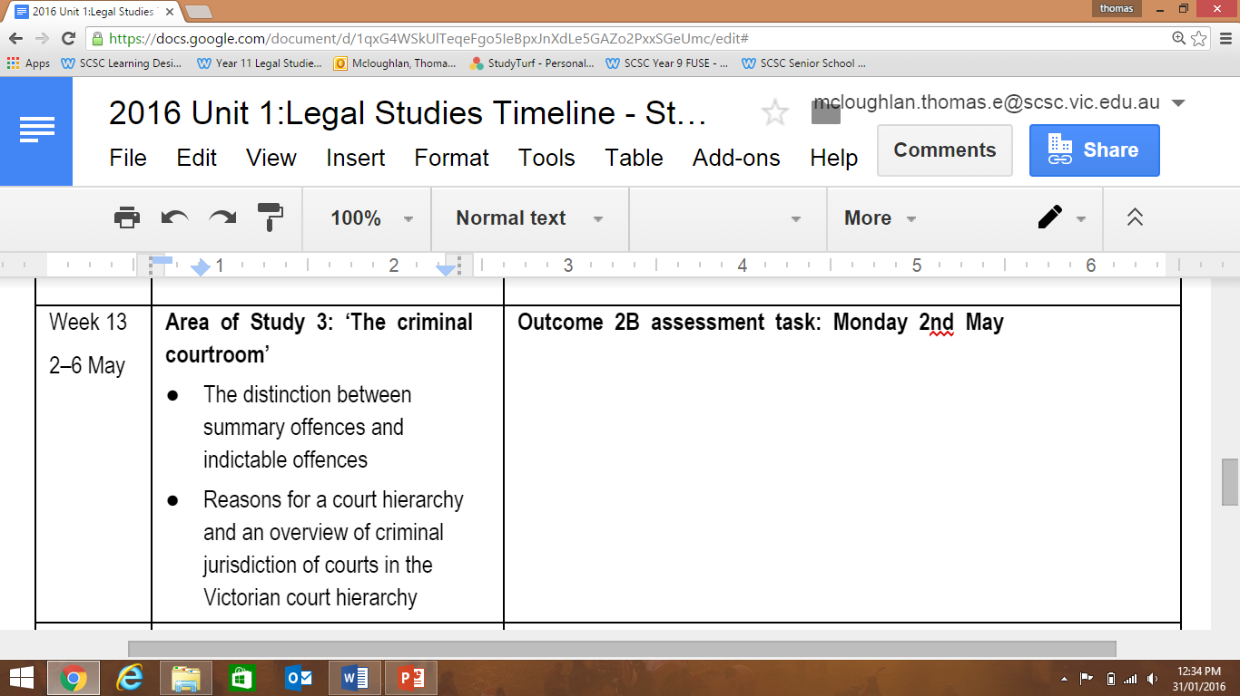

Slide 18
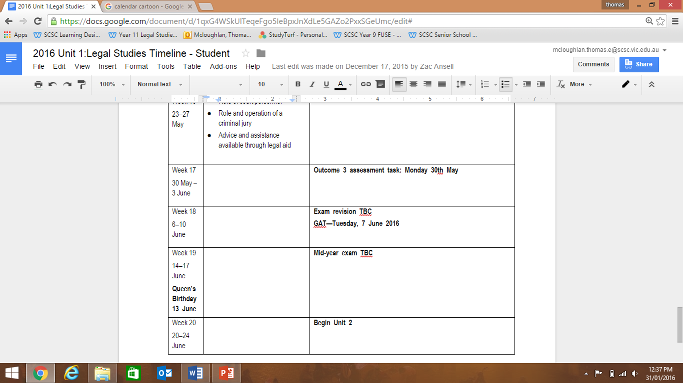

Slide 19
Sacs
SACs in Unit 1 are all tests
You will always have 2 weeks notice before the SAC
Please check the Unit outline for SAC dates (this will be updated.)

Slide 20
A quick activity

Slide 21
As a class
Why do we have rules?
Why do we have laws?
What is the difference between a legal rule and a non-legal rule? Give examples.
Who enforces the law?
Who makes laws?
What would happen if rules and laws did not exist in society today?

Slide 22
In groups of 4 – imagine there were no laws….ever
Most legal rules (laws) are enforced to protect people’s rights, which apply to civil as well as criminal matters. Laws allow people to go about their everyday lives generally feeling safe and secure and with the knowledge that they have certain freedoms. They apply to most facets of life, such as the use of roads, driving a car, the home, relationships including family relationships, work, purchasing goods and services, religion and school.
Discuss each of the following questions.
Imagine if there were no laws? What do you think would happen without laws?
Would you feel safe going out? Why? Could you leave your house and be confident that your valuables would still be there when you returned? Why?
What would you do tomorrow if there were no laws? Would you go to school for instance?
Would your parents feel safe at work? Would they feel confident that they would not be dismissed, that they would receive their annual leave and long-service leave entitlements, and that their employer would continue making superannuation contributions.

Slide 23
Relevance for youth
Go to the Weebly homepage.
Select the Am I Old Enough? button.
On the next slide there is a table of things your group needs to find out.

Slide 24
Are you ready???

Slide 25
Find the following answers
How old do you have to be before you can leave school?
How old do you have to be before you can be suspended from school?
What is the minimum age for working?
How many hours are you legally allowed to work?
How old do you have to be before you can pay tax and get a tax file number?
How old do you have to be to open a bank account?
At what age can you rent a house or flat?
At what age can you drive a car?
How old do you have to be to vote?
At what age can you make a will?
At what age can you get a tattoo?
What is the legal age for gambling?
At what age can you drink and possess alcohol?
At what age can you get married?
At what age can you get a body piercing?

Slide 26
And the dreaded bit

Slide 27
Holiday homework

Slide 28
weebly homepage – Chapter 1 button
Read chapter 1
Answer the “apply your understanding” questions 1-7 on page 14
Read the case study “ Witchcraft” on page 17 and answer the questions underneath

Slide 29
Good Luck

Slide 30
I might see you next year
Email me if you have any questions

